Slide 1
FLUORIDATION CHEMICALS ARE
UNREGULATED
UNTESTED
UNAPPROVED
INEFFECTIVE
DRUGS
By
Gilles Parent, ND.A.
Co-Author of «Fluoridation: Autopsy of a Scientific Error»
APRIL 19th, 2018

Slide 2
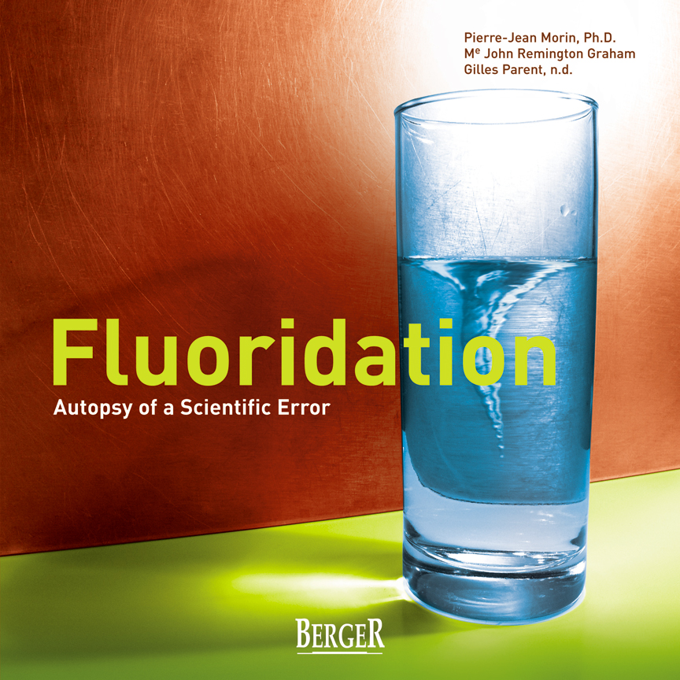

Slide 3
2012 PEEL RESOLUTION
February 12, 2012 Passed a Resolution calling Health Canada to do at least:
1 long-term toxicology study to determine the health effects in humans
at least 1 properly conducted controlled clinical trial to determine effectiveness
Objective:
to reassure the citizens of Peel that the use of fluorosilicates added to drinking water for the purpose of treating a disease is safe.

Slide 4
2017 PEEL RESOLUTION
February 22, 2017 Passed a Resolution calling Ministry of Health and Long Term Care to do at least:
To undertake appropriate and comprehensive toxicity testing necessary to reassure the public that the use of HFSA in water fluoridation treatments is safe;
Take legislative responsibility for the regulation and administration of HFSA in water fluoridation treatments across the province relieving local governments from what is a provincial responsibility.

Slide 5
ANSWER LETTER OF MINISTRY OF HEALTH TO PEEL REGION
MINISTRY OF HEALTH’S RESPONSE LETTER TO PEEL REGION
«March, 23, 2018
Public health Ontario has review NSF/ANSI 60 on behalf of the ministry. NSF/ANSI 60 establishes requirements to be protective of human health for products and their impurities that may be added directly during water treatment, storage and distribution.»
...

Slide 6
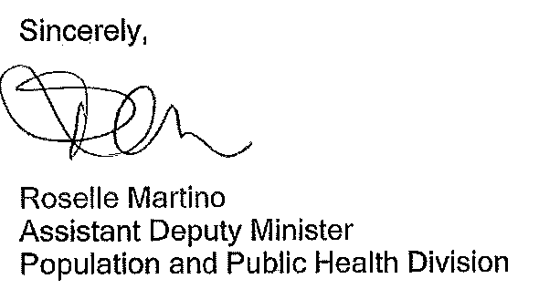
MINISTRY OF HEALTH’S RESPONSE LETTER TO PEEL REGION
«The established safeguard noted above continue to ensure the safety of fluoridate drinking water in Ontario. The ministry will also continue to monitor and review new research.
The ministry urges all municipalities to protect their communities from avoidable health issues by maintaining fluoride in their drinking water, to promote the health of all residents.»

Slide 7
MINISTRY OF HEALTH’S RESPONSE LETTER TO PEEL REGION
Ms Roselle Martino, assistant Deputy Minister is misleading the Committee :
The Ministry hasn’t supplied the toxicological review as requested by Peel Region to prove safety of HFSA, so without it, it cannot be claimed SAFE;
The Ministry implies that NSF/ANSI 60 establishes requirements to be protective of human health for fluoridation chemicals WHICH THEY DO NOT (see NSF disclaimers);
The Ministry implies that NSF/ANSI 60 has the jurisdiction and the competence to guarantee the efficiency of HFSA WHICH IT DOES NOT;
The Ministry implies that it is legal and ethical to administer to a population a water treatment chemical to mitigate and prevent a disease WHICH IT IS NOT.

Slide 8
MINISTRY OF HEALTH’S RESPONSE LETTER TO PEEL REGION
The Ministry assumes that fluoridation would supply to each citizen an exact and proper amount of fluoride when using tap water as a vehicle for the administration of the fluoride without considering the huge variability of daily intake of water and fluoride from all other sources. It make fluoridation of water an absurd vehicle of distribution of a drug as a daily dose cannot be controlled.
The Ministry assumes erroneously that concentration is equivalent to dose while such a concept is obviously invalid.
The Ministry assumes that it knows the exact daily dose of fluoride needed to prevent dental decay without causing any harm to anyone, including the most vulnerable subjects in the society; babies, children, the infirm, the elderly and those that drink a lot of water.
The Ministry assumes that it knows what no health authority in the world knows, the exact effective and safe dose of fluoride; that is either 1, 2, 3, 4, 5, 6 or 7 mg daily. There aren’t any scientific consensus on the exact effective and safe dose.

Slide 9
MINISTRY OF HEALTH’S RESPONSE LETTER TO PEEL REGION
The Ministry assumes that it knows what no health authority in the world knows, the exact effective and safe dose of fluoride that would take in account the weight of the subject expressed in mg/kg/day; is it 0.01, 0.02, 0.03, 0,04, 0.05, 0.06, 0,07, 0.08, 0.09 mg/kg/day.
Without knowing what the exact appropriate intake of fluoride that would be safe for the most vulnerable and that would be effective to prevent decay if such a dose would be proven safe and effective, the Ministry is putting the entire population at risk of side effects, including dental fluorosis that is already reported at an epidemic levels.

Slide 10
NSF/ANSI 60
TRADE REGULATORY ORGANIZATIONS
NO LEGAL JURISDICTION ON PRODUCTS USED FOR TREATING OR PREVENTING A DISEASE.
NO COMPETENCY IN EVALUATING THE EFFECTIVENESS OF A SUBSTANCE USED FOR A THERAPEUTIC PURPOSE.
NO COMPETENCY IN EVALUATING THE SAFETY OF A SUBSTANCE USED FOR A THERAPEUTIC PURPOSE.

Slide 11
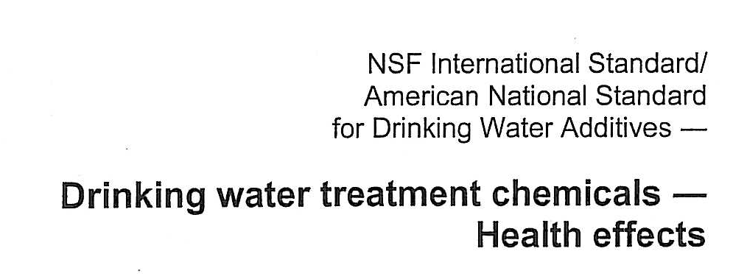
NSF DOCUMENTS

Slide 12

NSF DOCUMENT DISCLAIMERS
NO CANADIAN OR AMERICAN GOVERNMENTAL AGENCY HAS EVER PROVIDED SAFETY TOXICOLOGY STUDIES

Slide 13
FOOD AND DRUG ACT DEFINITIONS
“drug”
“drug” includes any substance or mixture of substances manufactured, sold or represented for use in
  (a) the diagnosis, treatment, mitigation or prevention of a disease, disorder or abnormal physical state, or its symptoms, in human beings or animals,
  (b) restoring, correcting or modifying organic functions in human beings or animals

Slide 14
FOOD AND DRUG ACT DEFINITIONS
FOOD
Prohibited sales of food
4. (1) No person shall sell an article of food that
(a) has in or on it any poisonous or harmful substance;
      (b) is unfit for human consumption;
      (c) consists in whole or in part of any filthy, putrid, disgusting, rotten, decomposed or diseased animal or vegetable substance;
      (d) is adulterated; or
      (e) was manufactured, prepared, preserved, packaged or stored under unsanitary conditions.

Slide 15
FOOD AND DRUG ACT DEFINITIONS
“food”
“food” includes any article manufactured, sold or represented for use as food or drink for human beings, chewing gum, and any ingredient that may be mixed with food for any purpose whatever;
(WATER IS A FOOD BY DEFINITION)

Slide 16
FOOD AND DRUG ACT DEFINITIONS
“Unsanitary conditions”
“unsanitary conditions” means such conditions or circumstances as might contaminate with dirt or filth, or render injurious to health, a food, drug or cosmetic.

Slide 17
FOOD AND DRUG ACT DEFINITIONS
Unsanitary manufacture, etc., of food
7. No person shall manufacture, prepare, preserve, package or store for sale any food under unsanitary conditions.

Slide 18
FOOD AND DRUG ACT DEFINITIONS
Deception, etc., regarding food
5. (1) No person shall label, package, treat,
  process, sell or advertise any food in a manner
  that is false, misleading or deceptive or is likely
  to create an erroneous impression regarding its
  character, value, quantity, composition, merit
  or safety.

Slide 19
LEGAL CLASSIFICATION OF FLUORIDATION CHEMICALS
TOXIC AND DANGEROUS SUBSTANCES?
DRUGS?
NATURAL HEALTH PRODUCTS?
MINERAL NUTRIENTS FOR FOOD FORTIFICATION?
FOOD ADDITIVES?
WATER TREATEMENT CHEMICALS?

Slide 20
CLAIMED PURPOSE
DEFINES
THE LEGAL NATURE OF A PRODUCT
AND ITS
APPLICATIONS OF LAWS
PERTINENT TO IT

Slide 21
WHY FLUORIDATION ?
Claimed to prevent dental cavities?
OR
2. To make drinking water safe/potable?

Slide 22
Products making
SPECIFIC HEALTH CLAIMS e.g. Preventing Cavities
ARE DEFINED AS EITHER :
DRUGS
OR
NATURAL HEALTH PRODUCTS
THEY MUST THEN COMPLY WITH
STRICT REGULATIONS

Slide 23
Supreme Court of Canada
1957¹
Fluoridation
  is a "compulsory preventive medication",
  is “not to promote the ordinary use of water as a physical requisite for the body”
  has a “special health purpose”.
Ruling never contested by the
Canadian Government.
1- Metropolitan Toronto v. Forest Hill (Village), [1957] S.C.R. 569 http://csc.lexum.umontreal.ca/en/1957/1957scr0-569/1957scr0-569.html

Slide 24
ARE THEY CONTROLLED AND APPROVED BY HEALTH CANADA AS DRUGS OR
NATURAL HEALTH PRODUCTS?
NO...
Petition #299, Answer #1 by Health Canada to the the Auditor General of Canada, available from:http://www.oag-bvg.gc.ca/internet/English/pet_lp_e_938.html

Slide 25
ARE THESE FLUORIDATION CHEMICALS APPROVED BY HEALTH CANADA AS
MINERAL NUTRIENTS FOR FOOD FORTIFICATION?
NO...
Petition #299, Answer #1 by Health Canada to the the Auditor General of Canada, available from:http://www.oag-bvg.gc.ca/internet/English/pet_lp_e_938.html

Slide 26

IF DRUGS, NATURAL HEALTH PRODUCTS OR SOURCES OF A NUTRIENT FOR FOOD FORTIFICATION, THEY MUST BE PREPARED AND STORED IN HYGIENIC CONDITIONS
AND HAVE TOXICOLOGICAL TESTS

Slide 27
FLUORIDATION CHEMICALS ARE NOT PREPARED WITHIN «GOOD MANUFACTURING PRACTICES» («GMP»)
Any drug, natural health product, nutrient for food fortification or food should be prepared in sanitary conditions required to satisfy the Food and Drug Act related to the «Good Manufacturing Practices» («GMP»)

Slide 28
DOES HEALTH CANADA EXERT ANY REGULATION ON FLUORIDATION CHEMICALS?
NO...
Petition #299, Answer #1 by Health Canada to the the Auditor General of Canada, available from:http://www.oag-bvg.gc.ca/internet/English/pet_lp_e_938.html

Slide 29
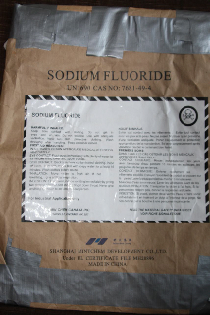
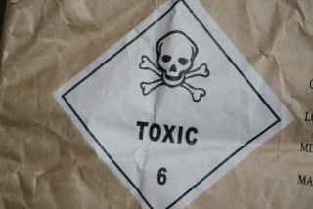
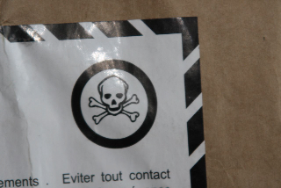
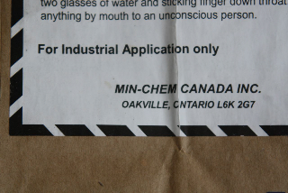
Bag from the water treatment plant of the City Bécancour

Slide 30
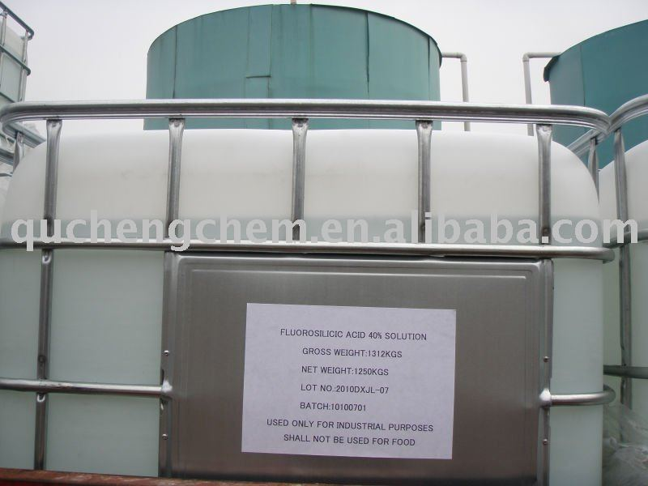
SHALL NOT BE USE AS FOOD

Slide 31
THEN,
WHAT
ARE
FLUORIDATION
CHEMICALS?

Slide 32
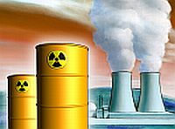
Fluoridation chemicals are unprocessed scrubber liquor of the phosphate industry smoke stack emissions or manufactured from fluoroapatite
If these emissions are released in the atmosphere, they are air pollutants
If these emissions are released in the river, they are
water pollutants
When these same chemicals are added to the municipal water and somehow, they become a beneficial nutrient good for your teeth and your overall health...

Slide 33
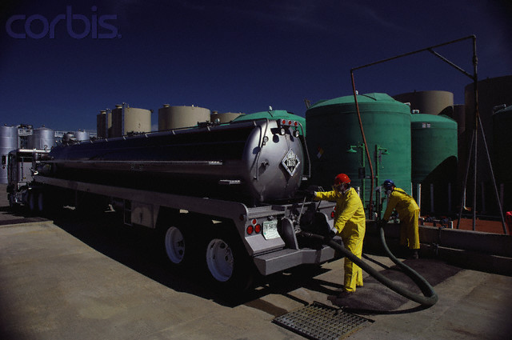
Fluoridation chemicals are usually recycled toxic waste
It comes with a small quantity of arsenic, lead, chromium, mercury, and nucleotides.

Slide 34
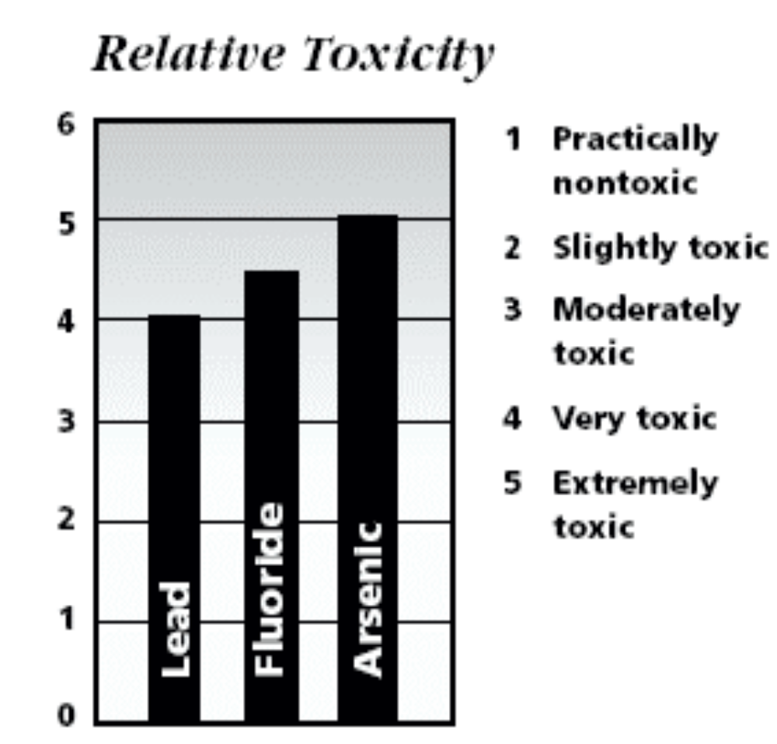
Fluoride Toxicity
SOURCE: base on lethal (LD 50) de Robert E.Gosselin and al, 1984. Clinical Toxicology of Commercial Products 5th ed., Williams and Wilkins, Baltimore.

Slide 35
Untested, uncontrolled, unregulated chemical waste taken directly from the industry and dripped into your drinking water
Not of pharmaceutical grade
nor
food grade
but
industrial grade
fluoride.

Slide 36
Are Fluoridation Products “Natural”?
NO...
They are MAN-MADE

Slide 37
ARE THEY WATER TREATMENT CHEMICALS?
HEALTH CANADA,
THE MINISTRY OF HEALTH AND
PUBLIC HEALTH AUTHORITIES
CLAIM THEY ARE.

Slide 38
ARE THEY REALLY WATER TREATMENT CHEMICALS?
NO...
Their aim is not to treat the water
to make it safe and drinkable.
Their aim is to prevent dental cavities.

Slide 39
ARE FLUORIDATION CHEMICALS COMPLIANT WITH STANDARD 60 OF THE NATIONAL SANITATION FOUNDATION (NSF)?
NO...
They have a NSF certificate but do not meet all the requirements of
NSF Standard 60.

Slide 40
The main essential requirement for the NSF Standard 60 is chronic toxicological tests that demonstrate safety of the HFSA.
«Chronic» means «long term»

Slide 41
Are there any Chronic Toxicology Tests available for HFSA?
NO...
NSF Fact Sheet states that toxicological testing is required,
but the NIEHS 2001 Review, US EPA and Safety Data Sheets state they
DO NOT EXIST.

Slide 42
Sodium Fluorosilicate
Material Safety Data Sheet
11. Toxicological Information
11.1 Acute toxicity:
Inhalation: No data available.
Oral: LD50, rat, 125mg/kg (Sodium hexafluorosilicate)
Dermal: No data available.
Irritation: No data available.
Sensitization: No data available.
Comments: No data available.
11.2 Chronic toxicity: No data available.
11.3 Carcinogenic Designation: None
http://www.fluoridealert.org/pesticides/msds/sodium.fluorosilicate.solvay.pdf

Slide 43
Letters from the US Congressional Hearings
US EPA
National Institute of Environmental Health Sciences 2001 Review
HEALTH CANADA
ONTARIO MINISTRY OF HEALTH
NSF
state that fluoridation products do NOT have TOXICOLOGICAL STUDIES
Therefore...
They have not been proven safe...

Slide 44
IF FLUORIDATION CHEMICALS
DO NOT HAVE LONG TERM TOXICOLOGICAL STUDIES, THEN
SAFETY
CANNOT
BE DEMONSTRATED
They are not proven... safe...

Slide 45
Therefore...
They do not satisfy NSF Standard 60...

Slide 46
Therefore...
THE CERTIFICATION COULD BE CONSIDERED AS INVALID?
They are not compliant with Quebec and Ontario law (Ontario
Safe Drinking Water Act)

Slide 47
Finally, what are fluoridation chemicals?
IF NOT DRUGS?
IF NOT NATURAL HEALTH PRODUCTS?
IF NOT MINERAL NUTRIENTS FOR FOOD FORTIFICATION?
IF NOT FOOD ADDITIVES?
IF NOT WATER TREATMENT CHEMICALS?
THEY MUST BE HAZARDOUS WASTES?

Slide 48
FLUORIDATION CHEMICALS SATISFY ALL CRITERIA FOR HAZARDOUS AND TOXIC WASTES
Règlement sur les matières dangereuses c. Q-2, r.32, Loi sur la qualité de l'environnement (L.R.Q., c. Q-2, a. 31, 46, 70.19, 109.1 et 124.1)
Export and Import of Hazardous Waste and Hazardous Recyclable Material Regulations DORS/2005-149 (FEDERAL)

Slide 49
THE LEGAL CLASSIFICATION OF FLUORIDATION CHEMICALS AS HARZADOUS AND TOXIC SUBSTANCES ARE DETERMINED IN LAWS
13 laws et regulations
Loi sur les produits dangereux L.R.C. (1985), ch. H-3
Liste des substances toxiques – Annexe 1
Liste des substances d’intérêts prioritaire LSIP1.
Loi canadienne sur la protection de l'environnement -LCPE (1999) CH. 33
Loi de 1992 sur le transport des marchandises dangereuses (1992, ch. 34)
Règlement sur le transport des marchandises dangereuses
Règlement sur l'exportation et l'importation de déchets dangereux et de matières recyclables dangereuses (REIDDMRD)
Règlement sur les mouvements interprovinciaux des déchets dangereux
Loi interdisant la vente, l’importation et la publicité de produits dangereux
Règlement sur les produits chimiques et contenants de consommation (2001)
Règlement sur les matières dangereuses c. Q-2, r.32
Loi sur le contrôle des renseignements relatifs aux matières dangereuses
Convention de Bâle sur le contrôle des mouvements transfrontiers de déchets dangereux et de leur élimination

Slide 50
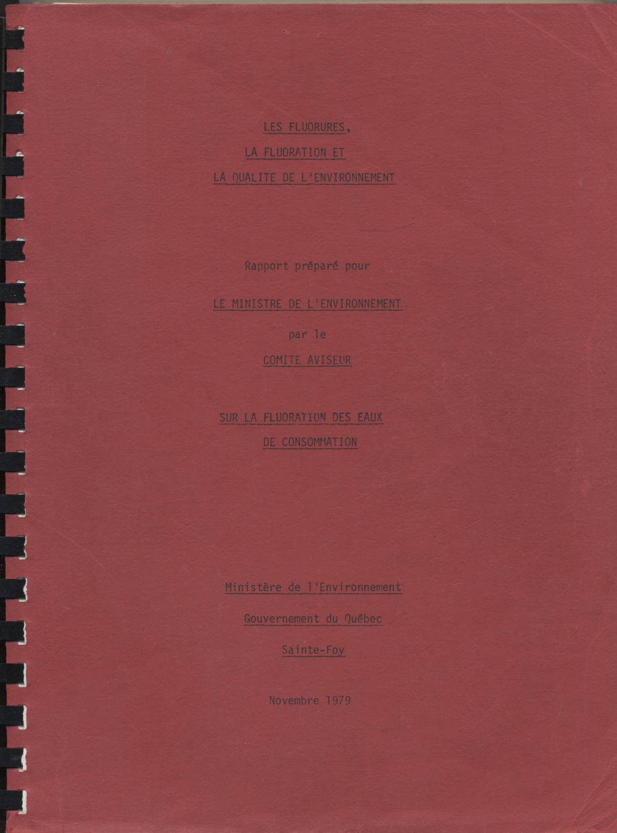
Copie électronique disponible sur le site web d’Action Fluor Québec à :
http://www.acmqvq.com/afq/audio-video/Livre%20Rouge-leger.pdf

Slide 51
TOXIC SUBSTANCES CAN FIT ONLY TWO CATEGORIES
TOXIC WASTES OR SUBSTANCES
DRUGS

Slide 52
HEALTH CANADA
HAS NOT APPROVED ANY FLUORIDATION CHEMICALS
AS DRUGS.
IT IS ILLEGAL TO ADMINISTER AN APPROVED OR UNAPPROVED DRUG
WITHOUT A MEDICAL LICENCE,
AND WITHOUT INFORMED CONSENT
TO ANY RESIDENT.

Slide 53
ADMINISTERING ANY DRUG,
APPROVED OR UNAPPROVED,
TO RESIDENTS
WITHOUT CONSENT CONTRAVENES
ARTICLE 7 OF THE
CANADIAN CHARTER OF
RIGHTS AND FREEDOMS

Slide 54
Drugs Should Not Be Put Into Drinking Water Because:
1. No one can control how much of any drug is consumed daily by each individual.
2. Citizens are deprived of Informed Choice:
  Information regarding risks and benefits
  Choice to refuse or accept drug
  No trained professional to assess medical need and adverse effects
MUNICIPALITIES SHOULD NOT USE THE PUBLIC WATER SUPPLY AS A VEHICLE TO ADMINISTER A MEDICATION TO THE POPULATION

Slide 55
Fluoridation chemicals
NOT Regulated = NOT Safe
Don’t we deserve
to be
protected by
Government regulation?

Slide 56
Who determines safety and efficacy of fluoridation chemicals ?
NO ONE!
NO Government Agency in Canada regulates fluoridation chemicals.

Slide 57
WHICH HEALTH AUTHORITIES CLAIM ACCOUNTABILITY FOR FLUORIDATION?
NONE…

Slide 58
NO ACCOUNTABILITY
It is not logical to accept the advice of those who accept no responsibility for these chemicals:
      Health Canada
      Ontario Ministry of Health
      Ontario Ministry of Environment
      Ontario Ministry of Health Promotion
      Ontario Dental Association
      And over 90 organisations who endorse fluoridation

Slide 59
Finally, who’s Accountable?
Municipalities are legally responsible:
      You, the councillors, are the final decision makers
      for choosing fluoridation chemicals
      for adding fluoridation chemicals
      .
Pleading ignorance of the law is not an excuse

Slide 60
False Assumptions
Tax payers incorrectly assume that these products are compliant with Canadian laws,
Tax payers incorrectly assume that these products have been assessed for safety,
Tax payers incorrectly assume that the product reduces cavities when swallowed,
Taxpayers incorrectly assume that the Health Canada panel evaluating these products had the necessary expertise,
Taxpayers incorrectly assume that the Health Canada panel reviewed all available research – not just the research that supports the policy.

Slide 61
3 methods for Removing Fluoride
1. Reverse Osmosis – water wasteful, expensive to purchase and maintain.
2. Distillation – expensive to purchase, removes beneficial minerals, energy user
3. Stop fluoridating – simple and free
Which is easier?
Which is cheaper?
Which is logical?

Slide 62
MINISTRY OF HEALTH’S RESPONSE LETTER TO PEEL REGION
THE MINISTRY'S RESPONSE DOES NOT ANSWER THE
REGIONS RESOLUTION
REQUESTING TO ASSURE THE RESIDENTS
OF THE SAFETY AND EFFICACY OF HFSA
FOR THE SOLE PURPOSE OF
PREVENTING DENTAL CAVITIES
TO ALL RESIDENTS OF PEEL
BY USING AN UNAPPROVED DRUG TO
MEDICATE THE RESIDENTS
WITHOUT THEIR INFORMED CONSENT

Slide 63
MINISTRY OF HEALTH’S RESPONSE LETTER TO PEEL REGION
AS YOU HAVE NOW LEARNED, THE PROVINCE HAS
NOT PROVIDED THE ANSWERS TO YOU
IN ORDER FOR REGIONAL COUNCIL
TO REPORT BACK TO THE CONCERNED RESIDENTS OF PEEL
WHO HAVE BEEN ASKING FOR
PROOF OF SAFETY AND EFFICACY SINCE 2011
NO EVIDENCE OF SAFETY AND EFFICACY (NOT ENDORSEMENTS)
MEANS
YOU CANNOT CLAIM SAFETY AND EFFICACY
THEREFORE, THE INFORMATION YOU ARE RELYING ON FROM
PUBLIC OFFICIALS IS INVALID AS CLAIMS FOR
SAFETY AND EFFICACY OF HFSA
MUST BE BACKED UP BY REQUIRED TOXICOLIGAL STUDIES
WHICH I HAVE CONFIRMED FOR YOU TODAY
DO NOT EXIST!

Slide 64
MINISTRY OF HEALTH’S RESPONSE LETTER TO PEEL REGION
THEREFORE, IT IS INCUMBENT UPON YOU, AS THE
ULTIMATE DECISION MAKERS,
TO PROTECT THE HEALTH AND WELL BEING OF THE RESIDENTS
YOU WERE ELECTED TO SERVE AND PROTECT.
PLEASE CEASE AND DISMISS THIS
UNREGULATED, UNTESTED, UNETHICAL, UNAPPROVED AND INEFFECTIVE PRACTICE
WITHOUT FURTHER DELAY!
ALL RESIDENTS OF PEEL HAVE THE RIGHT TO SAFE DRINKING WATER
WHICH IS A FUNDAMENTAL HUMAN RIGHT
PLEASE JOIN THE 95% OF THE WORLD THAT DOES NOT FLUORIDATE
REDIRECT $500,000.00 SPENT ON THE INEFFECTIVE FLUORIDATION
INTO PUBLIC HEALTH DENTAL PROGRAMS OF PREVENTION

Slide 65
WE HAVE PROVEN THAT
FLUORIDATION CHEMICALS ARE
UNREGULATED
UNTESTED
UNAPPROVED
INEFFECTIVE
DRUGS
THE PRECAUTIONARY PRINCIPAL
SHOULD BE APPLIED

